Slide 1
Obesity and Cardiovascular Disease
Notes:
Malinda Matney

Slide 2
Learning Objectives
Describe the relationships between obesity and cardiovascular risk factors, including how this risks are prevalent in some populations.
Explain the relationship between obesity and hypertension, and how this varies across populations
Understand the normal physiological regulation of blood pressure
Explain the role of the sympathetic nervous system in the regulation of blood pressure
Understand how adaptive responses to obesity are associated with increased blood pressure

Slide 3
Debating the concept of “Fat and Fit”
Mohsin Arsiwala

Slide 4
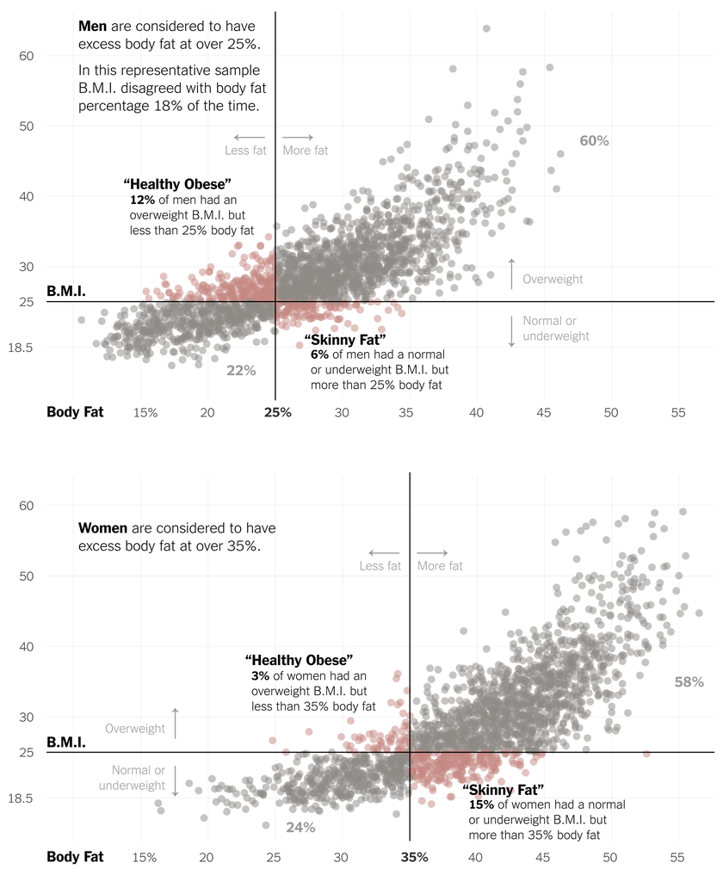
Introduction
Source: https://www.nytimes.com/interactive/projects/cp/summer-of-science-2015/latest/how-often-is-bmi-misleading

Slide 5
The News Article
CNN: “Fat but fit' still has higher risk of heart disease, study confirms”
Very strongly denied the redirect that there is a group of “fat and fit”
Talked about a recent study that found that people who were previously categorized as “fat but healthy” are at a 28% risk of coronary heart disease
Used cholesterol levels, blood glucose, and blood pressure to measure health→ So those with normal levels of those were put in the healthy category
Used BMI to measure obesity
Described the sample well: , European Prospective Investigation into Nutrition and Cancer, which contained more than a half a million people, as well as sampling 10,000 healthy people as a control group
Article does a good job simplifying the scientific source for the lay public

Slide 6
So Was it Accurate??
The article actually did a good job summarizing the actual scientific source
As expected, the study found a significant risk for those who were metabolically unhealthy
Studies made some bold claims about the metabolically healthy group
“Population-wide prevention and treatment of obesity is therefore warranted, regardless of metabolic health.” → Final sentence of implications
There odds ratio was 1.28 for metabolically healthy obese people; 95% Confidence Interval: 1.03-1.40
Article = a little bit extreme; had quotes that the category of healthy and obese doesn’t exist, which was not completely supported

Slide 7
Implications for Public Health
Adds to the uncertainty of the category of people who are considered healthy and obese
Highlights the need for more specific research on this category
European study→ questionable applicability to the United States
Emphasizes the need to move away from labelling someone who is classified as overweight or obese as inherently unhealthy.

Slide 8
Discussion
How would you approach a conversation about health with someone classified as overweight or obese?
In what ways can Public Health approach this intersection between health and obesity?
How do you think news articles like this one affect stigma for overweight and obese people?

Slide 9
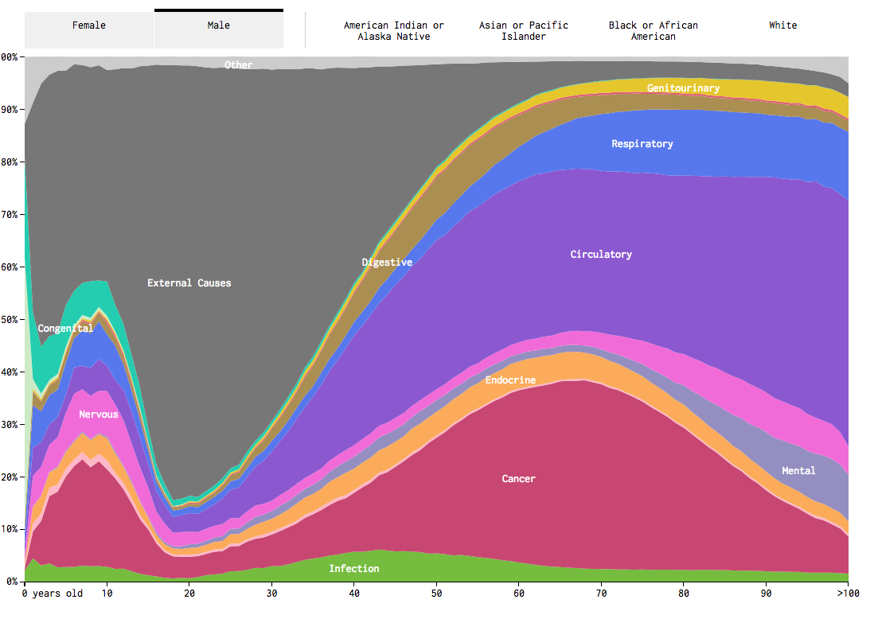
Heart Disease
Leading cause of death (about ¼)
One every 40s in America
Someone dies every minute
Stochastic events as opposed to progressive like diabetes
https://flowingdata.com/2016/01/05/causes-of-death/

Slide 10
What are some other risk factors for CVD?
Hypertension
Cholesterol and triglyceride levels
More LDL (bad cholesterol)
Less HDL (good cholesterol)
Diabetes
Smoking
Age
Low physical activity
Notes:
47% of americans have at least one risk factor

Slide 11
Problems Associated with Hypertension
Increased cardiac load
Potential clot formation
Damage to highly vascularized tissues

Slide 12
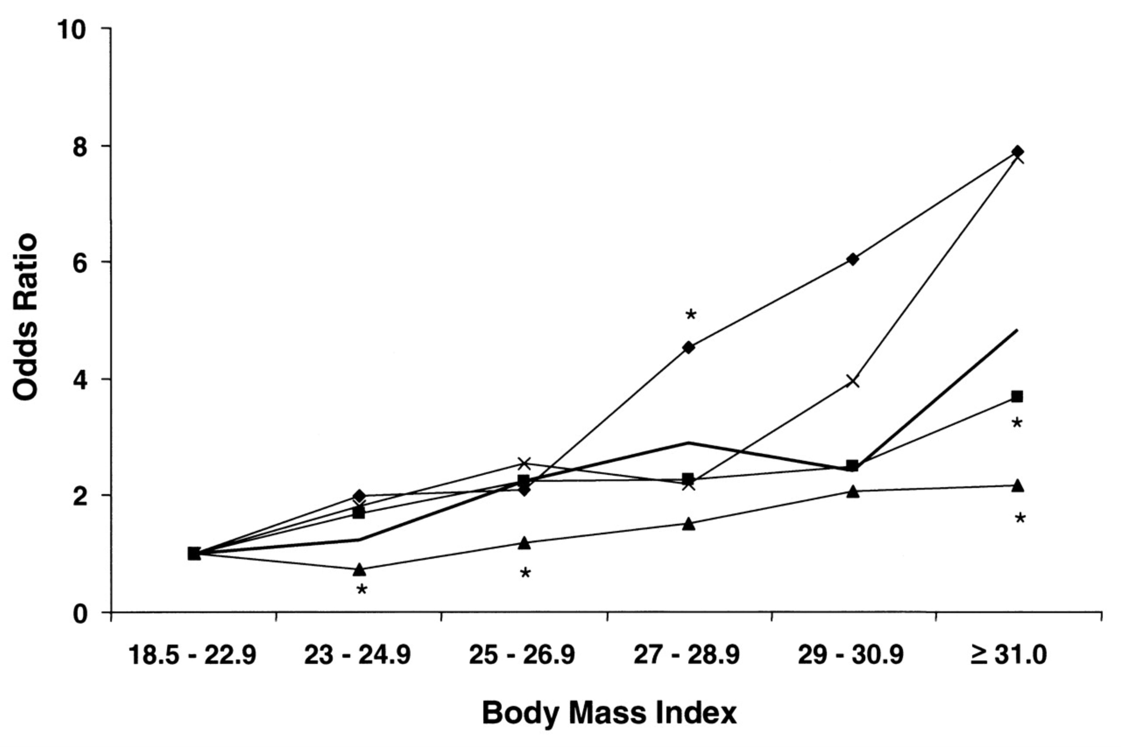
Obesity and Hypertension
African American
Chinese
White
Chinese
White
Mexican American
Mexican American
African American
Colin BA, Adair LS, Popkin BM. Ethnic differences in the association between body mass index and hypertension. Am J Epidemiol. 2002; 155: 346–53. doi: 10.1093/aje/155.4.346.
Notes:
FIGURE 2. Age-adjusted odds of having hypertension over a range of body mass index (weight (kg)/height (m)<sup>2</sup>) categories, by ethnic group, among women from three health surveys (the China Health and Nutrition Survey (1997), the Cebu Longitudinal Health and Nutrition Survey (1998), and the Third National Health and Nutrition Examination Survey (1988–1994)). ♦, Chinese; ×, non-Hispanic White; ▴, non-Hispanic Black; ▪, Mexican-American; —, Filipino. (<sup>*</sup>p < 0.05 for difference from non-Hispanic White women).
12

Slide 13
Normal Regulation of Blood Pressure
How do you think chronic stress (i.e. cortisol) would affect blood pressure?
Key Mediators:
Noradrenaline (from CNS)
Adrenaline (From Adrenal)

Slide 14
Obesity modification of blood pressure

Slide 15
Thinking About Mechanisms Linking Increased Weight to Hypertension
First as a group discuss how obesity affects energy expenditure
Increased energy expenditure is due to sympathetic nervous system activity
How would this adaptation affect blood pressure?
Thinking about this pathway, how might weight loss affect hypertension

Slide 16
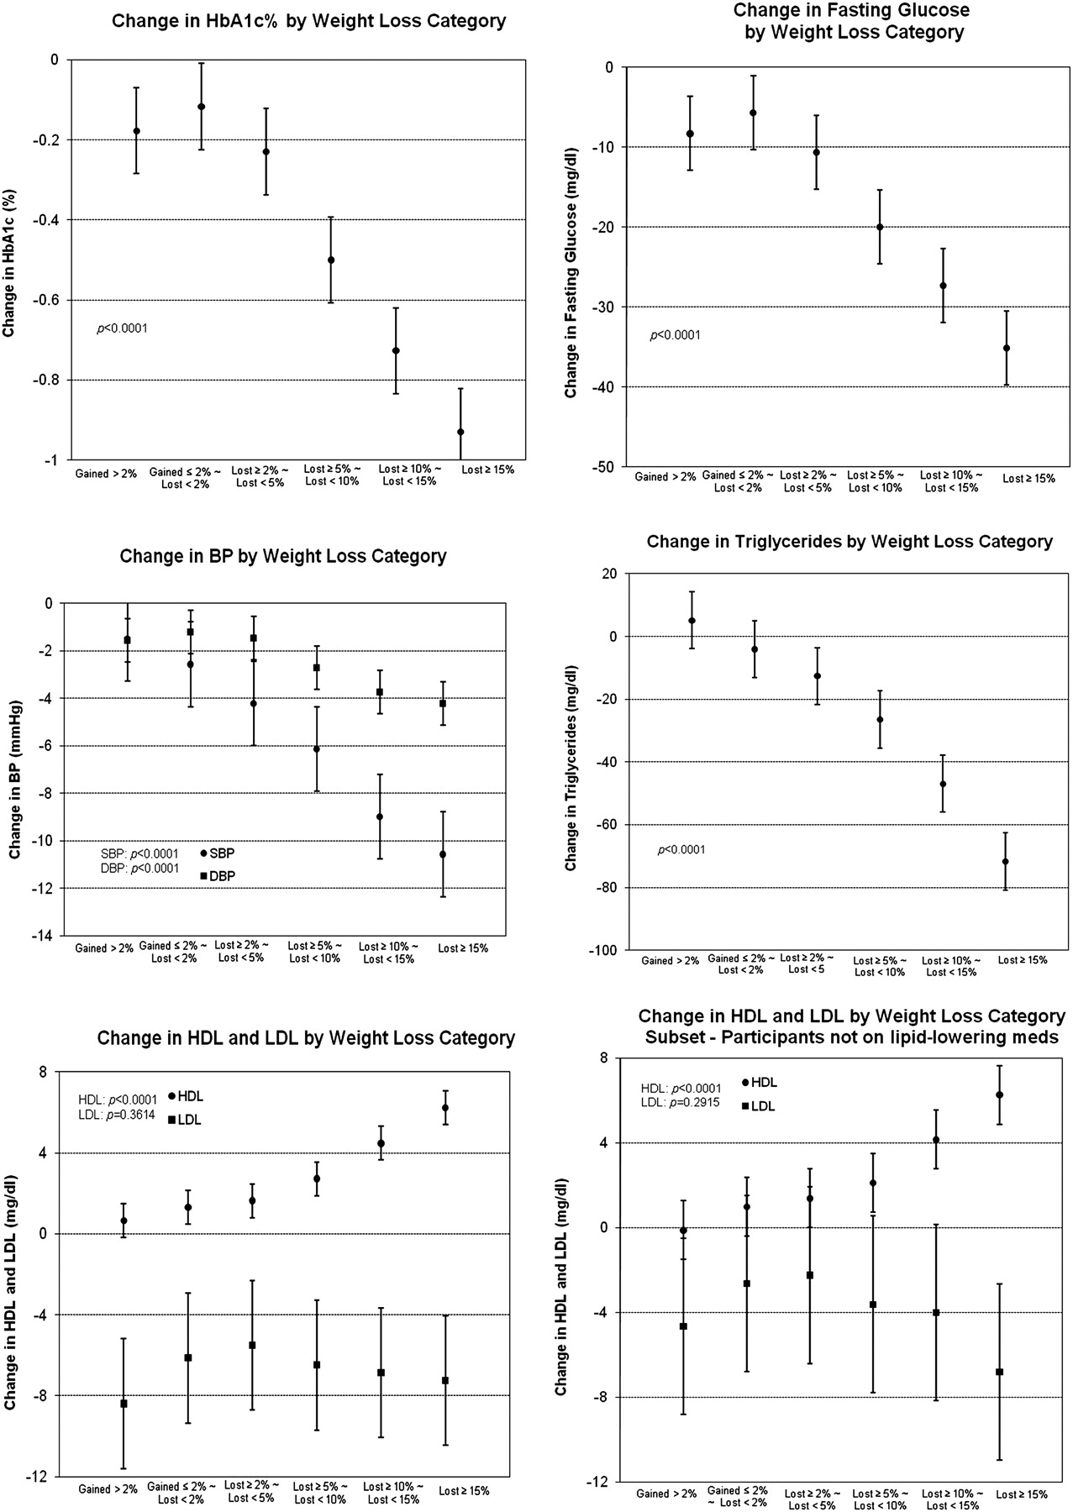
Modest Weight Loss -> Big Improvements
Wing R, Lang W, Wadden T, Safford M, Knowler W, Bertoni A, Hill J, Brancati F, Peters A, Wagenknecht L. Benefits of Modest Weight Loss in Improving Cardiovascular Risk Factors in Overweight and Obese Individuals With Type 2 Diabetes. Diabetes Care. 2011; 34: 1481–6. doi: 10.2337/dc10-2415.

Slide 17
Cholesterol and Coronary Artery Disease

Slide 18
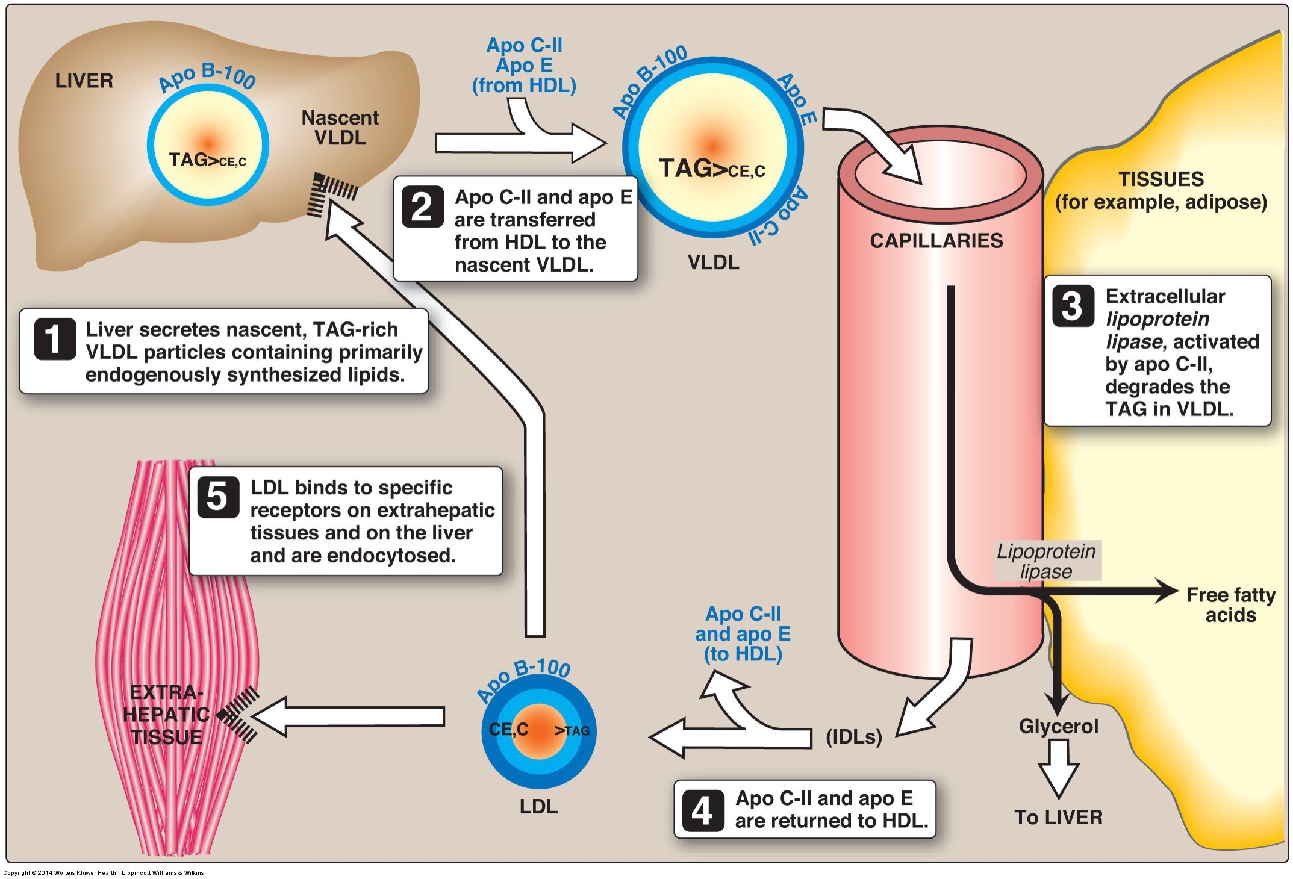
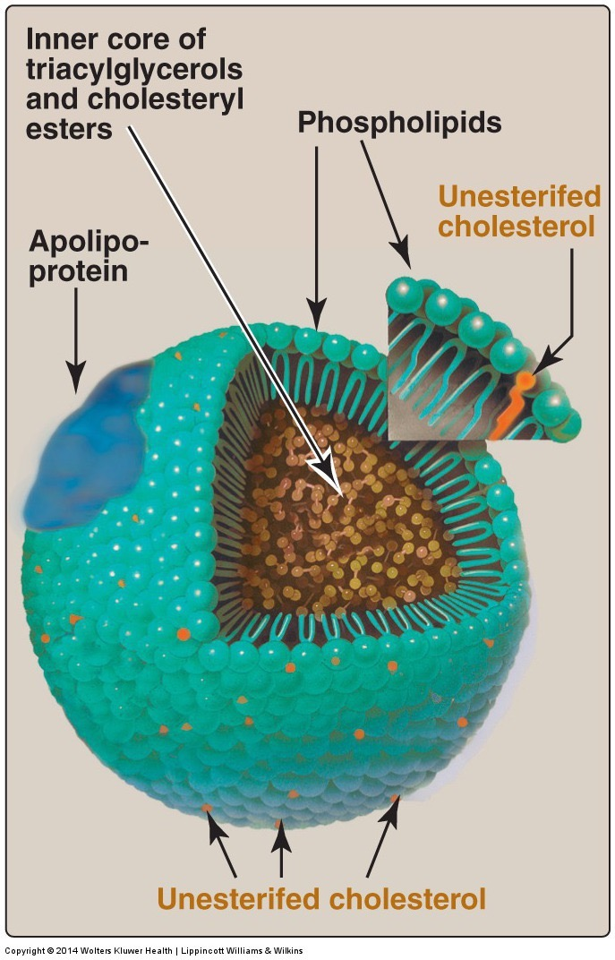
How does the liver release triglycerides?

Slide 19
Talk to folks nearby
How do you think fatty liver disease would relate to LDL-Cholesterol levels?
What do you think would happen to VLDL production and to LDL retrieval in the liver?
Notes:
Increased export of VLDL and decreased uptake of LDL

Slide 20
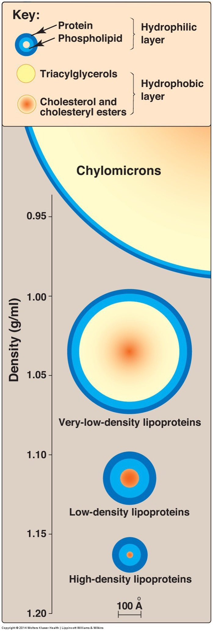
If muscle and adipose arent using the VLDL…
Build up of blood lipoproteins (LDL)
Excess lipoproteins accumulate in walls of blood vessels

Slide 21
Atherosclerosis and Thrombosis
Increased blood pressure because
Reduces arterial flexibility
Diabetes also causes stiffened arteries
High pressure can lead to release of thrombus
Heart – Heart Attack
Brain - Stroke

Slide 22
Connections between Insulin Resistance Hyperlipidemia, and Circulatory Diseases
Obesity -> increased SNS -> higher blood pressure
Obesity -> Insulin resistance
Insulin resistance/diabetes -> more liver fat
Diabetes -> stiffened arteries -> higher blood pressure
Higher blood pressure and Diabetes -> vascular disease
Liver fat -> more glucose production and insulin resistance -> Diabetes
Higher blood pressure and atherosclerosis -> thrombosis
Liver Fat -> less particle retrieval -> more LDL
More LDL -> more atherosclerosis -> higher blood pressure

Slide 23
Metabolic Syndrome
Diagnostic criteria (3 of 5)
Waist >40” (M) or 35” (F)
Fasting Glucose >100
Triglycerides >150
HDL < 40 (M) and <50 (F)
Blood Pressure >130 (systolic) or >85 (diastolic)

Slide 24
Concept Map

Slide 25
Concept Mapping Exercise
Try to sketch out the relationships between these concepts
Obesity
Narrowed Arteries
Atherosclerosis
Energy Expenditure
Liver Fat
Increased Blood Glucose
Diabetes
Sympathetic Activity
Insulin Production
Thrombosis
Insulin Resistance
Lipolysis
Increased Blood Lipids
High LDL and Low HDL
Vascular flexibility
Cardiac function
Chronic stress
Cirrhosis
Lipolysis
Hepatic Gluconeogenesis
Cancer Growth
Leptin/Melanocortin Signaling

Slide 26
Obesity and recovery from heart failure
According to American Heart Association
17 M heart attacks/strokes per year
One every ~40s in America
Paradoxically a high BMI seems somewhat protective after heart failure
Why might this be?
Obese
Lean

